Slide 1
An Update From Your Franklin County Auditor’s Office
2023 Mass Reappraisal
Board of Revision
Homeowner Assistance Program
Property Tax Reduction Programs
Property Search
Weights and Measures
Dog Licensing

Slide 2
2023 Mass Reappraisal: What’s Next
First-half tax bills due to the Franklin County Treasurer January 31.
Property values across Franklin County rose on average approximately 40% following the 2023 Mass Reappraisal
For Class 1 (All residential and agricultural) properties, the pre-levy property tax increase was 6.12%
The voter-approved levies added an additional 6% of tax across Franklin County.
Countywide, on average this translates to approximately an additional 12% in property tax.
For the average Class 1 property in Franklin County (calculated at $186,287 in 2022 and at $259,378 in 2023) this equates to an average change of $279 pre-levies and $546 post levies.

Slide 3
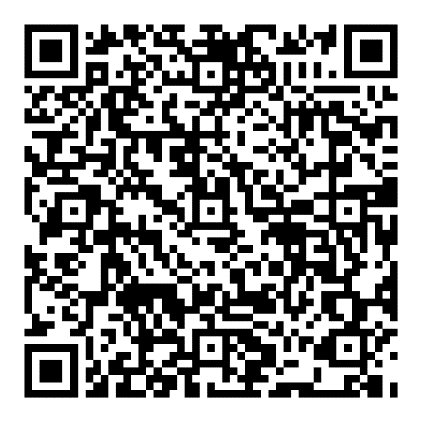
Board of Revision (BOR)
The BOR was established primarily to review all valuation complaints of real property.
Any owner of property in Franklin County may contest a property value by filing a complaint form.
BOR only has jurisdiction for the current tax year. In our case, this would be Tax Year 2023.
A property owner can submit evidence to support value reduction, such as:
Sale documents, appraisals, photos, estimates, comparable sales, and income/expense statements (if applicable).
A property owner can only apply once in a three-year period, unless one of the following exceptions applies:
Property transfer;
Substantial improvement was made;
Casualty to the property;
15% occupancy change; or
Auditor’s office changed the value.
This three-year period restarts after every triennial update and sexennial reappraisal.
To help homeowners navigate the BOR process, the Auditor’s office is holding multiple walk-in clinics over the next few months at locations across the county. Times and locations are on the Auditor’s office website.
BOR Mobile Clinic Locations and Times

Slide 4
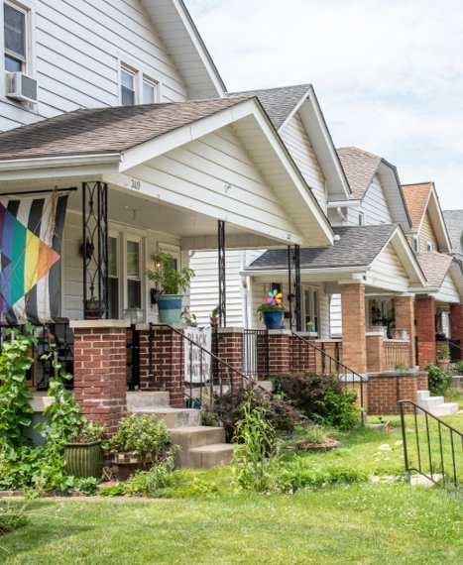
Homeowner Assistance Program
Partnership between the Franklin County Auditor’s Office and Legal Aid Society of Columbus, entering its fourth year
Increases access to the Franklin County Board of Revision Process for households with less than $75,000 annual income
Connects homeowners to volunteer attorneys and real estate professionals to think through required paperwork and the value of their home

Slide 5
The Homestead Exemption
Statewide program that allows qualified senior citizens and permanently and totally disabled homeowners to reduce their property tax by shielding some of the auditor’s appraised value of their home from taxation.
For 2024, the homestead exemption for seniors and disabled persons allows eligible homeowners to exempt the first $26,200 of their home’s appraised value from taxation. For example, an eligible owner of a home with an auditor's appraised value of $100,000 will be billed as if the home were valued at $73,800.
To qualify, a homeowner must meet the following requirements:
Own and occupy the home as their primary place of residence
Be 65 years of age or be totally and permanently disabled as of January 1 for the year for which they apply or be the surviving spouse of a person who was receiving the homestead exemption at the time of death
Have a total household income that does not exceed the amount set by state law. For the current year, the income requirement is $38,600.
For full requirements, visit https://www.homestead.franklincountyohio.gov
​

Slide 6
Property Tax Assistance Program (PTAP)
Onetime financial assistance of partial or full payment of current homeowner property taxes for qualifying older adults or those with a documented permanent disability
Application deadline (for second half of year tax bill): April 19, 2024
To complete, download application or call 614-525-HOME (4336)

Slide 7
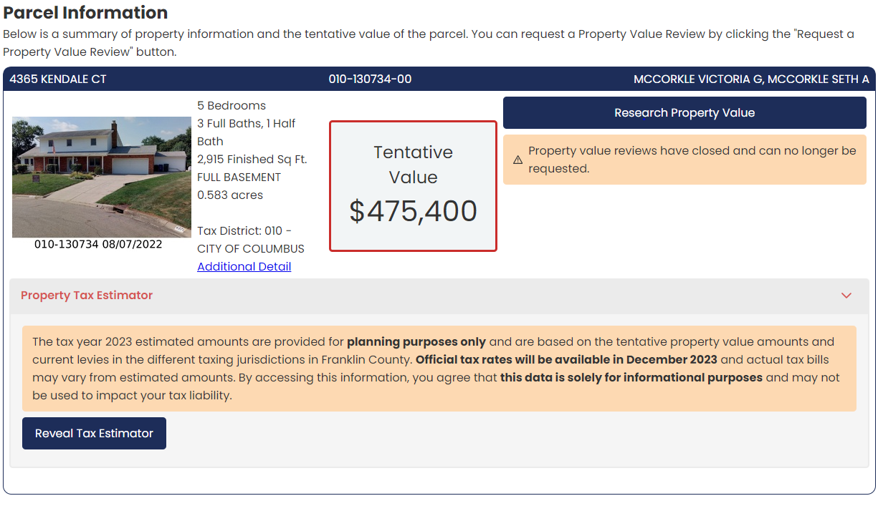
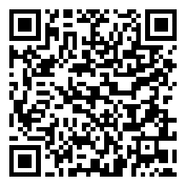
Property Search
Search any property in Franklin County on the Auditor’s office website
You can search properties by Owner Name, Address or Parcel Number
Compare properties across neighborhood, municipality, school district, county and state using advanced GIS mapping tools
Visit the Property Search Homepage

Slide 9
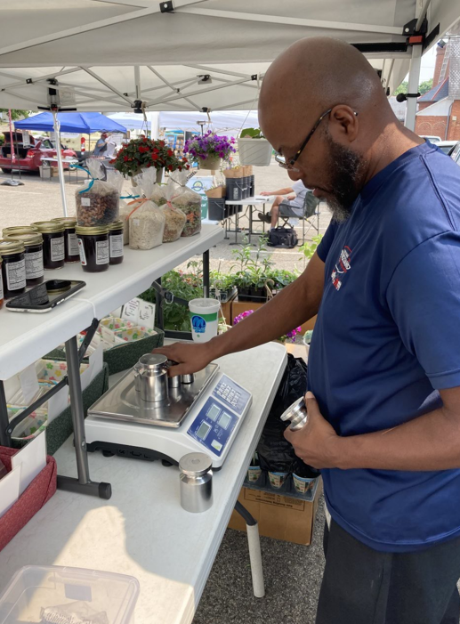
Weights & Measures
The Franklin County Auditor is the Sealer of Weights & Measures for businesses in Franklin County, excluding those located in the City of Columbus’
The auditor is required to see that Ohio laws relating to weights and measures are strictly enforced and shall assist in the prosecution of violations within his jurisdiction.
Some of the devices inspected and tested are fuel meters, retail devices, price verification systems (U.P.C. scanners), packages (such as deli foods, meat and/or food that is packaged), mulch, firewood, taxi meters and more.
Each device is inspected at least once a year. The inspectors work to protect consumers and merchants by ensuring that the weighing and measuring devices are correct and accurate.
The True Transactions Award is a recognition given by the Franklin County Auditor’s office to businesses that have a flawless record of using accurate scanners and scales that have been verified by Auditor’s office Weights and Measures inspectors.

Slide 10
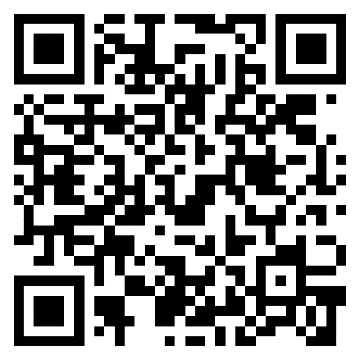
Dog Licensing
Ohio law requires that all dogs have a valid license.
One year, three year and permanent licenses are available for purchase.
Fees support the Franklin County Dog Shelter and Adoption Center
You can license your dog online at https://doglicense.franklincountyohio.gov/
Dog Licensing Website

Slide 11
Questions?
Contact:
AuditorStinziano@FranklinCountyOhio.gov
614-525-HOME (4663)

